Slide 1
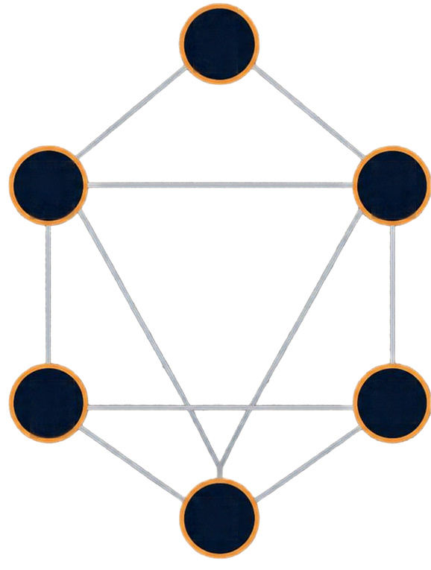
Introduction to
Minimum
Spanning Tree ((MST))
A
4
2
1
B
C
A graph connects vertiices wiith edges
7
5
8
6
Edge weights represent costs
D
E
An MST connects allll vertiices wiithout cyclles
IIt achiieves the minimum totall edge weiight
2
4
F

Slide 2

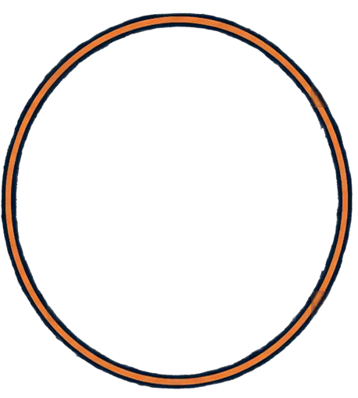




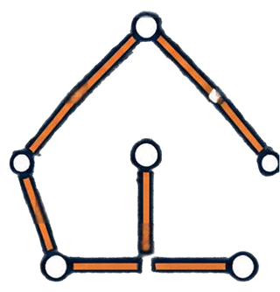





Applications of
Minimum Spanning Tree
MST connects allll llocatiions wiith the lleast totall cost..
4
Network desiign
2 7
Water piipelliine systems
1
Road and raiillway pllanniing
Tellecommuniicatiions
3
5
Computer networks
Ellectriicall wiiriing

Slide 3

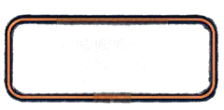


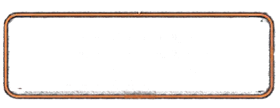




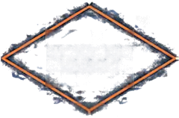
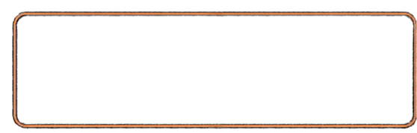


Prim’s Algorithm
Greedy method that grows the MST from a starting vertex by repeatedly adding the minimum weight edge.
ALGORITHM FLOW
PSEUDOCODE
Start from any vertex
Prim(G, s)
for each v in V
key[v] = ∞ , parent[v] = NIL key[s] = 0
Q = all vertices in V while Q is not empty
u = vertex in Q with minimum key[v] remove u from Q
for each v adjacent to u
if v in Q and weight(u, v) < key[v] key[v] = weight(u, v)
parent[v] = u
HOW IT WORKS
Start from any vertex.
Find minimum weight edge connecting visited set to an unvisited vertex
Keep a set of visited vertices.
Choose the minimum weight edge that connects the visited set to an unvisited vertex.
Add edge and vertex to MST
Add that vertex and edge to the MST.
All ve^{N}rºtices included?
Repeat until all vertices are included.
TIME COMPLEXITY
O(V²)
with adjacency matrix
O(E log V)
with priority queue
Stop

Slide 4



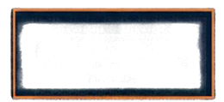


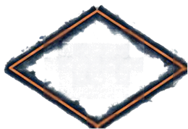
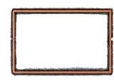



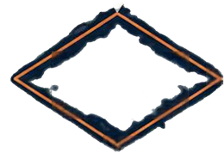


Kruskal’s Algorithm
Start
PSEUDOCODE
Kruskal(G):
MST ← Ø
for each vertex v in G:
MakeSet(v)
sort edges by non-decreasing weight for each edge (u, v) in sorted order:
Sort all edges by non-
decreasing weight
A greedy algorithm that builds a minimum spanning tree.
Pick the smallest edge (u, v)
if Find(u) ≠ Find(v):
Sort edges by weight and add the smallest edge that does not create a cycle.
Do u and v belong to the same set?
Yes
MST ← MST U {{u, v}}
Union(u, v)
Discard the edge
No
return MST
Cycle detection is done using Union-Find (Disjoint Set).
Add edge to MST and union the sets
CYCLE DETECTION WITH UNION-FIND
Union-Find maintains disjoint sets of vertices.
Have we added
\V| – 1 edges?
No
Find(x) returns the set representative of x.
TIME COMPLEXITY
O(E log E)
Union(x, y) merges the sets containing x and y. An edge is added only if its endpoints are in different sets.
Yes
Return MST

Slide 5
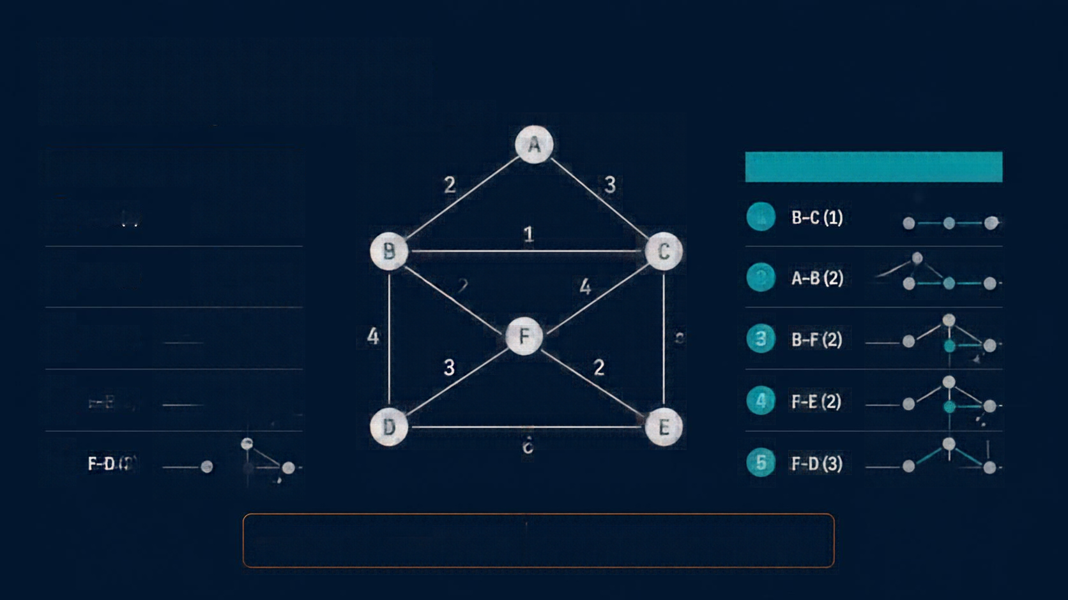
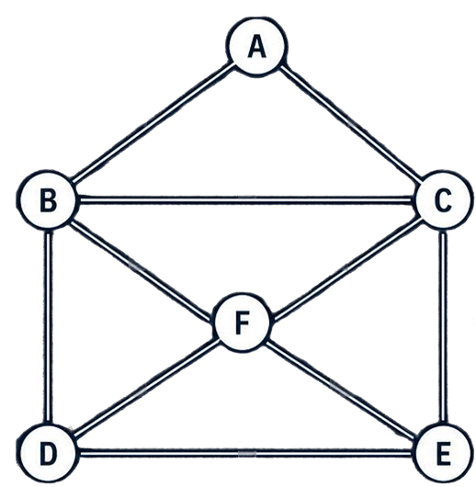










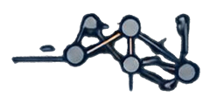



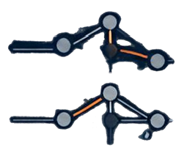
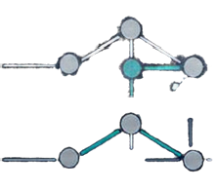





Working Example
Prim’s and Kruskal’s algorithms on the same weighted graph.
PRIM’S ALGORITHM
2
3
KRUSKAL’S ALGORITHM
1
A–B (2)
1
B–C (1)
1
2
B–C (1)
2
4
2 A–B (2)
3
B–F (2)
4
5
3
B–F (2)
3
2
4
F–E (2)
4
F–E (2)
6
5
F–D (3)
5
F–D (3)
prim’s step
prim’s mst
kruskal’s step
kruskal’s mst

Slide 6

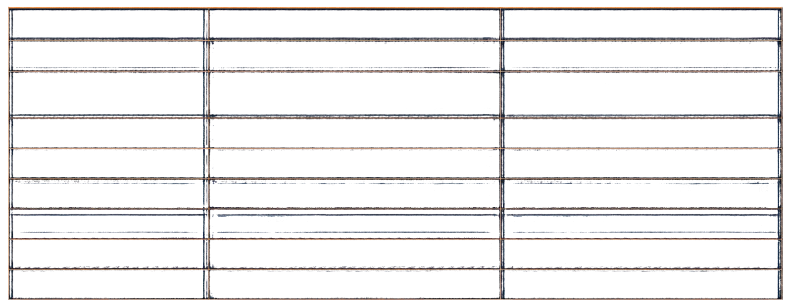
Comparison of
Prim’s and Kruskal’s Algorithms
Attribute | Prim’s Algorithm | Kruskal’s Algorithm
Approach | Grow a single tree from a starting vertex | Build a forest by adding safe edges
Starting Point | Starts from any chosen vertex | No specific starting point
Edge Selection Method
Choose minimum edge connecting the tree to a new vertex
Choose the global minimum edge that doesn’t form a cycle
Cycle Detection
Not required
Required (Union–Find)
Data Structure Used
Priority Queue (Min-Heap)
Disjoint Set (Union–Find)
Time Complexity
O(E log V)
O(E log E)
Best Suited For
Dense graphs
Sparse graphs
Advantages
Simple, efficient on dense graphs
Efficient on sparse graphs, flexible
Disadvantages
Less efficient on sparse graphs
Requires extra structure for cycle check

Slide 7
Thank You!
Subject - design and analysis of algorithm
Name - Kiran Satpute PRN - 25070521294 SEC/SEM-E2/III
Tool used - Canva

